Slide 1

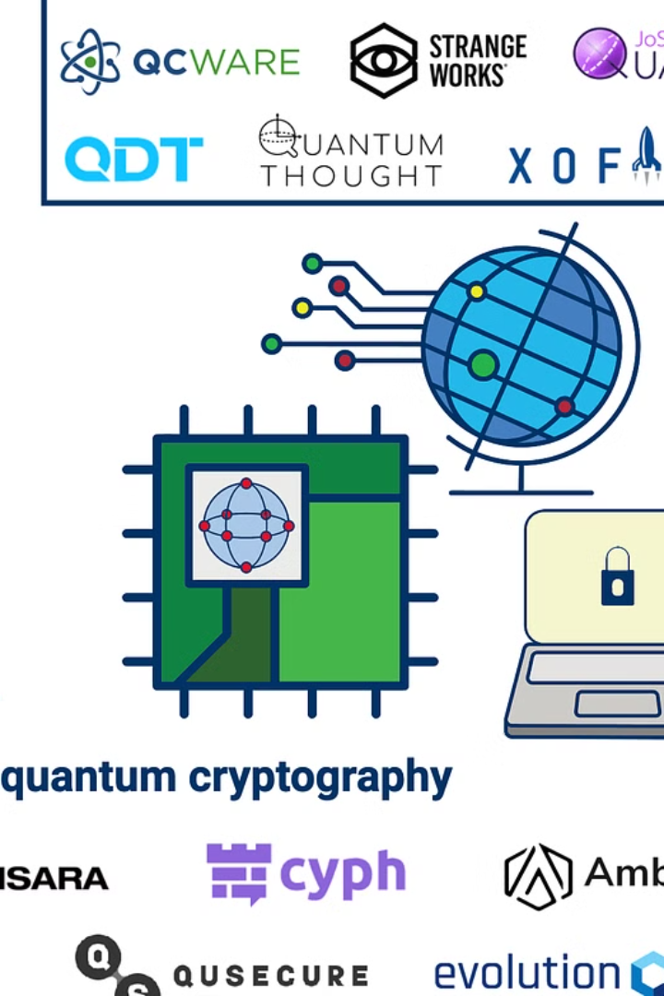

Current Applications of Quantum Computing
Quantum computing is currently being utilized in various industries, including finance, healthcare, and logistics. Its advanced processing power and ability to handle complex algorithms make it valuable for tasks such as optimization, drug discovery, and secure communication.
In finance, quantum computing is being used to tackle complex data analysis and modeling, enabling more accurate risk assessments and portfolio optimization. In healthcare, quantum algorithms are aiding in the analysis of large genomic datasets, accelerating personalized medicine research. Additionally, in logistics, quantum computing is being explored for optimizing supply chain operations and solving complex routing problems.
Moreover, quantum computing has shown potential in the field of materials science, where it is being used to simulate the behavior and properties of molecules and materials with high precision and accuracy. Furthermore, quantum computing is also being researched for its application in cryptography, as it offers the promise of unbreakable encryption algorithms, ensuring secure communication and data transfer.

Slide 2

Quantum Computing in Industry
Finance
Healthcare
Logistics
Quantum computing is used for financial modeling, portfolio optimization, and risk analysis to improve investment strategies.
In healthcare, quantum computing aids in drug discovery, genomics, and personalized medicine for more accurate treatments.
Logistics benefit from quantum computing for route optimization, demand forecasting, and inventory management.

Slide 3
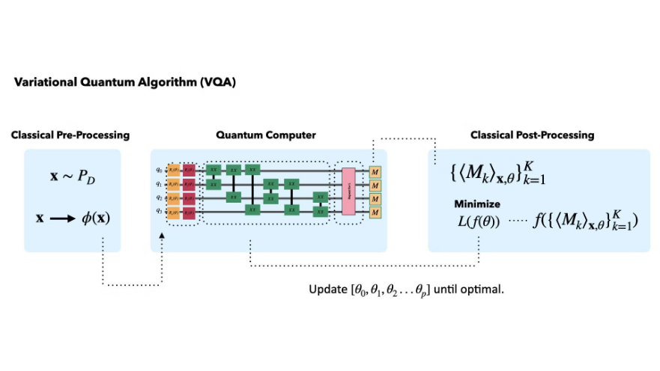
Quantum Computing in Research and Development
1
Quantum Cryptography
2
Quantum Simulation
3
Quantum Algorithms
Research is focused on developing quantum cryptography for secure data transmission and protection against cyber threats.
Quantum computers are used to simulate quantum systems, leading to advanced material and chemical discoveries.
Scientists are working on quantum algorithms for complex problem-solving in physics, chemistry, and biology.

